Slide 1

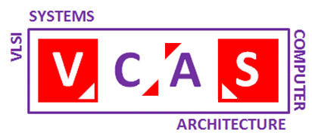
Development and Analysis of a Physically Unclonable Function Circuit
UNIVERSITY OF IOANNINA -
DEPARTMENT OF COMPUTER SCIENCE AND ENGINEERING
Soldatou Christina Olympia, AM 4001
Supervisor: Prof. Georgios Tsiatouhas
Ioannina, February 2025

Slide 2
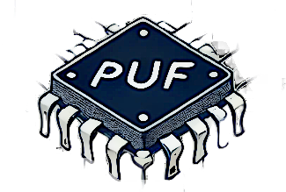
An Introduction to Physically Unclonable Functions (PUFs)

Slide 3
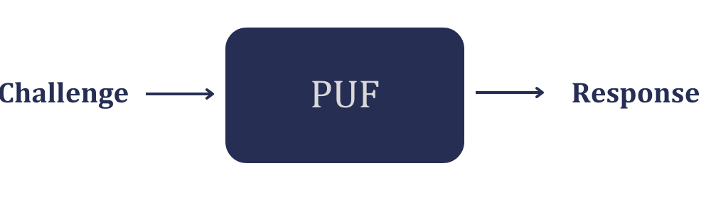
What are Physically Unclonable Functions (PUFs)?
Definition & Purpose:
PUFs utilize inherent physical variations in circuits to generate unique responses.
Act as a "digital fingerprint" for secure authentication.
Advantages: No need for key storage, resilient against cloning.
Key Characteristics:
Unclonability: Cannot be cloned due to physical variations.
Randomness: Die-to-die responses must be unpredictable.
Reliability: Responses remain stable under different environmental conditions.
Functionality Takes an input (challenge) and generates an output (response).

Slide 4
Challenge-Response Pairs (CRPs)
Criterion | Weak PUFs | Strong PUFs
Number CRPs | Limited | Vast, exponentially increasing
Security | Vulnerable to brute force attacks. | Resistant to attacks
Applications / Usage | Key storage, device ID | Hardware authentication, IoT security
Computational Complexity | Simple, low cost | Complex, higher cost
Examples | SRAM PUF, POK | Arbiter PUF, RO-PUF, XOR-PUF
Scalability | Linear/polynomial growth | Exponential growth
Unclonability | Limited | Very high

Slide 5
PUF Architectures
Delay-Based PUFs
Arbiter PUF (APUF): Compares signal delays, vulnerable to ML attacks.
Ring Oscillator PUF (RO-PUF): Uses frequency differences, more resilient but has limited CRPs.
Memory-Based PUFs
SRAM PUF: Utilizes random SRAM initialization, ideal for IoT.
DRAM/GPU PUFs: Exploits memory access patterns but requires hardware modifications.
Current-Based PUFs
SCA-PUF: Low-power, resistant to ML attacks.
PTAT PUF: High reliability due to thermal variations.
TCO-PUF: Enhanced version of SCA-PUF, resistant to ML attacks.
Compute-in-Memory (CIM) PUFs
SiCBit-PUF: Uses bitline conflicts in SRAM, suitable for SoCs.
PUF-CIM: Combines PUFs & CIM for secure computation and encryption.

Slide 6
Security Threats in PUFs
Machine Learning (ML) Attacks
Use of ML algorithms to predict PUF responses.
Vulnerable: Arbiter PUFs.
Side-Channel Attacks
Passive: Power and timing analysis.
Active: Temperature & voltage manipulations to alter responses.
Aging & Environmental Sensitivity
Temperature and power supply variations, as well as transistor aging reduce reliability.
Mitigation: Specialized error correction mechanisms.

Slide 7
Evaluation Metrics of PUFs
Uniqueness
Among identical PUFs, each PUF should generate unique responses with respect to the rest PUFs for the same input.
Ideal value: 50% (different devices → different responses).
Uniformity
Responses should be balanced (not biased).
Ideal value: 50% (equal distribution of 0s and 1s).
Reliability
Responses must remain stable regardless of temperature and voltage fluctuations, as well as aging.
Ideal value: 100% (zero fluctuations influence in the same device).

Slide 8
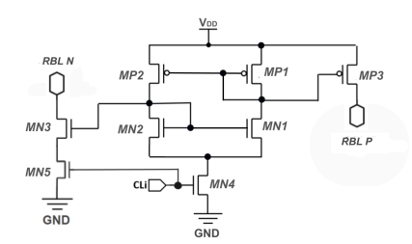
THE PROPOSED CURRENT-MODE PUF

Slide 9
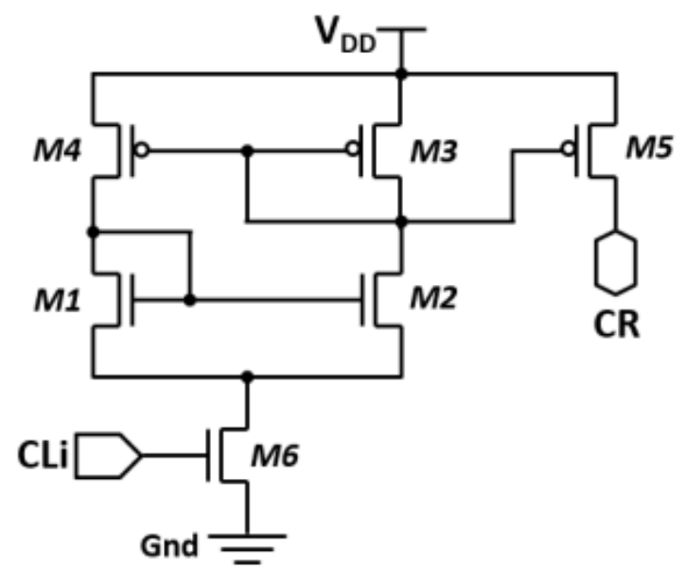
The 6T PUF as the Starting Point of the Thesis
What is the 6T PUF (CAS-PUF)?
Based on a six-transistor (6T) design with current mirrors.
Uses PMOS and NMOS mirrors to ensure stable current generation.
Activated by an NMOS switch (M6) based on the challenge input.
Why is it important?
Serves as the foundation of this thesis, where its design is analyzed and extended.
Maintains stable performance despite voltage variations.
Leverages fabrication randomness for secure and unclonable responses.
Strong and cost-effective, suitable for large-scale PUF arrays.
CAS-PUF: Current-mode Array-Type Strong PUF for Secure Computing in Area Constrained SoCs, D. Georgoulas et al, DATE, 2025

Slide 10
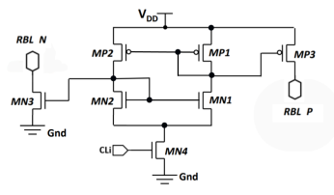
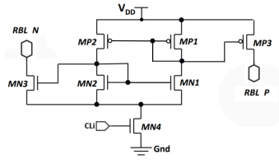
Analysis of Initial 7T PUF Designs
Initially designed with:
Addition of transistor MN3 to generate a second current flow.
Utilization of two bitlines (RBL_N & RBL_P) for current readout.
Despite these innovations, both 7T PUF designs were deemed unsuitable for the intended application.

Slide 11
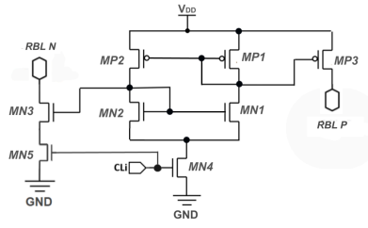
The Proposed 8T PUF Cell Design
Standby Mode (Inactive State)
Switch MN4 is OFF, preventing current flow.
Output nodes are pulled up to the supply voltage (VDD).
Minimal static power consumption → Reduces leakage currents.
Operation Mode (Active State)
Switches MN4 and MN5 are turned ON, allowing current to flow through the cell.
Current splits into two paths, feeding RBL_P & RBL_N bitlines.
Transistors MP3 & MN3 direct current to their respective bitlines.
Current mirrors ensure uniform current distribution.

Slide 12
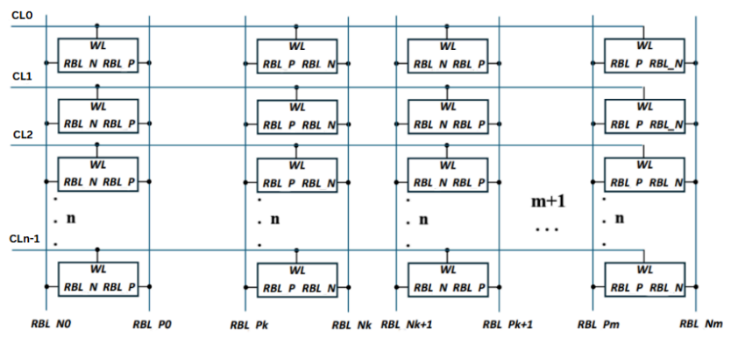
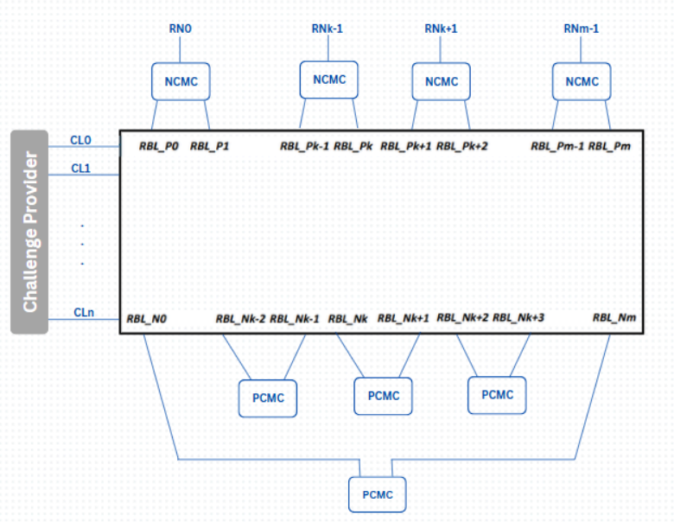
Proposed Current Mode Array PUF Design
Key Features
n × (m+1) 8T PUF array → Increased CRP count.
Rows activated by challenge bits.
Current flows into two bitlines (RBL_P & RBL_N).
Current-Mode Comparators
PCMC (P-type) → For RBL_N columns.
NCMC (N-type) → For RBL_P columns.
Unique, unpredictable output for each challenge.

Slide 13
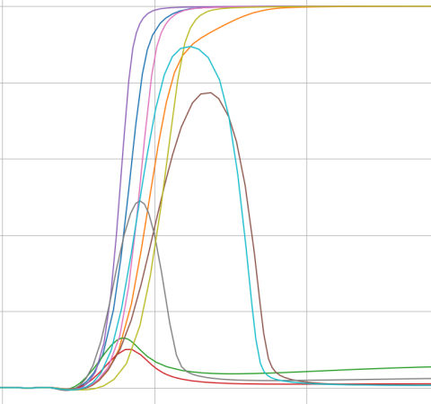
PUF DESIGN AND SIMULATION RESULTS

Slide 14
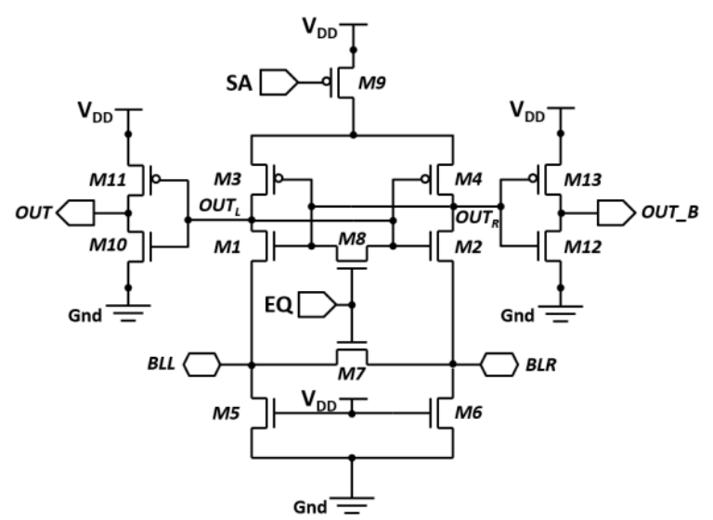
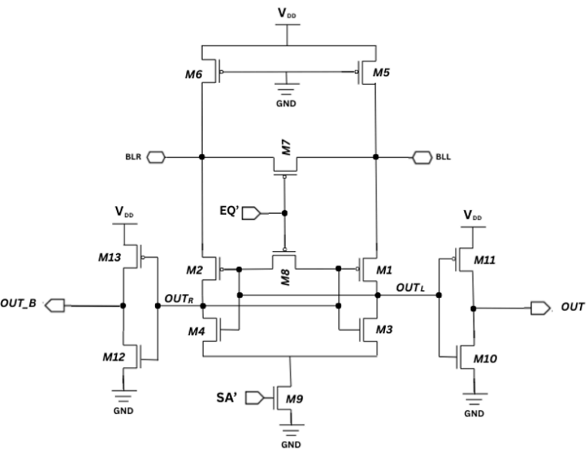
Comparators in Current-Mode PUFs
Role of Comparators
Compare bitline currents to generate reliable digital responses.
Each column drives two comparators (NCMC & PCMC).
N-type Current Mode Comparator (NCMC)
Uses a Current Mode Sense Amplifier (CMSA) to detect small current differences.
Includes a cross-coupled latch for fast response.
Selects the "winning" bitline with the highest current.
P-type Current Mode Comparator (PCMC)
Works in a complementary manner to NCMC.
NCMC
PCMC

Slide 15
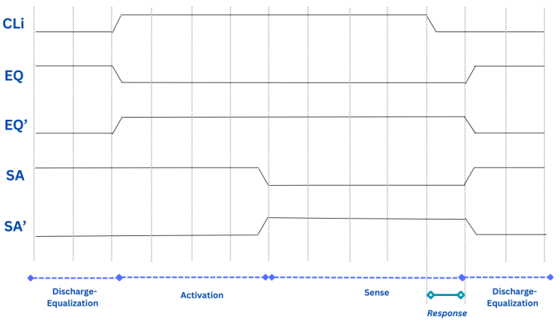
Operation Phases of the PUF
Discharge-Equalization
Initializes and resets bitlines.
Equalizes comparators for a stable initial state.
Activation
Challenge is applied to the PUF.
Corresponding PUF cell rows are activated.
Bitlines are fed by currents.
Sense
Comparators are activated.
Bitline currents are compared.
Digital response (0 or 1) is generated.

Slide 16
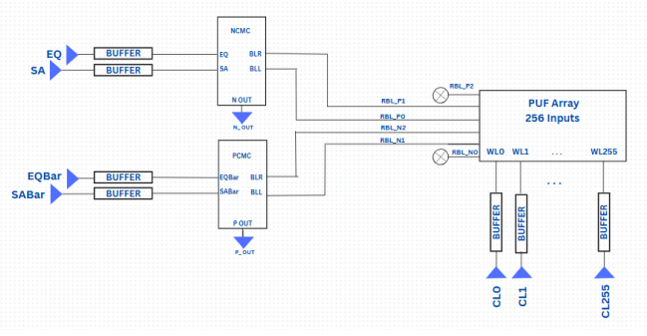
Overall Design
Main System Components
PUF Array with 256 challenge lines (CL0 - CL255) activating corresponding wordlines (WL).
Buffers feed the challenge to the PUF rows.
System Operation
Bitlines (RBL_P & RBL_N) carry currents to the comparators.
PCMC compares RBL_P → Generates P_OUT.
NCMC compares RBL_N → Generates N_OUT.
Control Signals (EQ, SA, EQBar, SABar) regulate operation phases.

Slide 17
Simulation Analysis
Library and Simulations
UMC 90nm CMOS technology used for simulations.
25 sessions, each with 5,000 Monte Carlo runs.
PUF Elements and Array Configuration
256 rows × 3 columns for simulation, scalable to 64 columns.
PUF outputs: RBL_P & RBL_N → Processed by NCMC & PCMC comparators.
Environmental and Challenge Conditions
Tested at 0°C, 27°C, and 80°C to assess reliability.
Voltage variations: ±10% (0.9V – 1.1V).
128 activated rows.

Slide 18
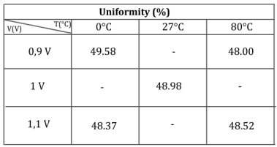
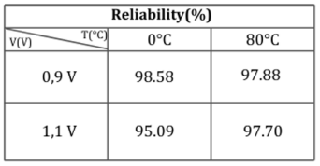
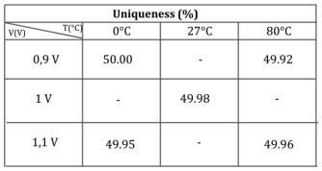
Performance Metrics & Reliability Analysis
Uniqueness → 49.96% (Ideal: 50%)
Uniformity → 48.57% (Ideal: 50%)
Reliability
Voltage variations: 95.09% – 98.58% (Average: 96.81%)
Temperature variations: 97.70% – 98.58% (Average: 98.04%)

Slide 19
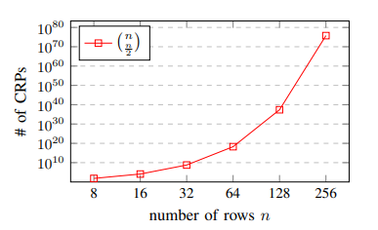


CRP Count
Challenge-Response Pairs (CRPs)
Total challenge lines (n): 256
Activated lines (k): 128 (maximum CRPs)
General Formula:
If 128 rows are activated:
CAS-PUF: Current-mode Array-Type Strong PUF for Secure Computing in Area Constrained SoCs, D. Georgoulas et al, DATE, 2025

Slide 20
Silicon Area & Energy Consumption
Silicon Area Estimation
PUF Array (256×64): 1,258.29 μm²
Buffers: 84.78 μm²
Comparators:
NCMC: 23.60 μm²
PCMC: 33.84 μm²
Total PUF area: 1,400.51 μm²
Energy Consumption
Measurement conditions: 1V, 27°C
Total consumption: 39.75 pJ/bit

Slide 21
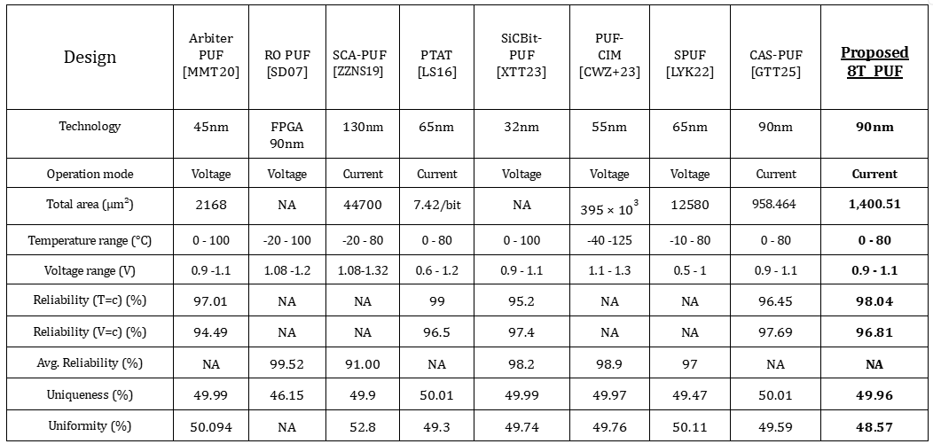

Slide 22
Conclusions
Proposed 8T PUF Design
Strong, reliable & scalable.
Resilient to temperature & voltage variations.
Performance Trade-offs
CAS-PUF → Lower power & smaller area → Best for low-power applications.
8T PUF → Higher reliability → Ideal for temperature-sensitive environments.
Comparison with CAS-PUF (6T Design)
8T PUF → Higher silicon area (1,400.51 μm² vs. 958.464 μm²).
Better temperature reliability but slightly lower voltage reliability .
No comparator interference → More accurate operation.
✔ Both designs provide strong PUFs and demonstrate adequate uniqueness & uniformity, making them robust for hardware security applications.
✔ The choice depends on the application’s priorities: area & power efficiency vs. enhanced reliability over temperature variations.

Slide 23
Thank you!

